Slide 1
B₁
B₃
B₆
B₇
m₁
7, 15, 13
14, 8
5
12
0
9
B₂
30
B₄
58
68
B₅
90
m₂
10
3, 6
4, 1, 2, 11, 9
0
7
27
67
94

Slide 2
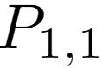
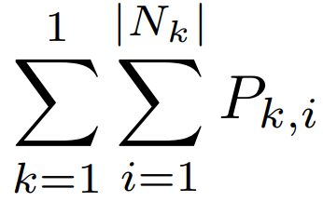
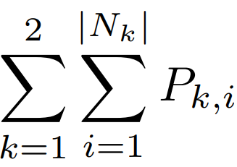
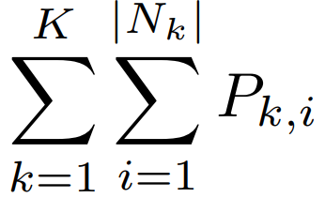
S₁
S₂
...
S_{k}
m₁
J1.1 J1.2 … J1.|N1|
J2.1 J2.2 … J2.|N2|
...
Jk.1 Jk.2 … Jk.|Nk|
0

Slide 3
B₁
B₃
B₆
B₇
m₁
7, 15
14, 8
5
12
0
8
B₂
25
B₄
53
63
B₅
85
m₂
10
6
4, 1, 2, 11, 9
0
7
27
53
80
B₁
B₃
B₆
B₇
m₁
7, 15
14, 8, 13
5
12
0
8
B₂
25
B₄
53
63
B₅
85
m₂
10
6
4, 1, 2, 11, 9
0
7
27
53
80
B₁
B₃
B₆
B₇
m₁
7, 15
14, 8, 13
5, 3
12
0
8
B₂
25
B₄
53
68
90
B₅
m₂
10
6
4, 1, 2, 11, 9
0
7
27
53
80

